Slide 1
STEREO-VISION and Depth Estimation
Presented by: Ziwen Guo

Slide 2
01
Stereo Vision Introduction
A quick overview of Stereo Vision and this Project

Slide 3
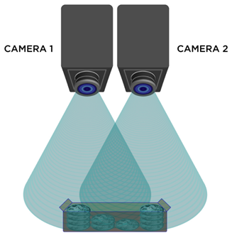
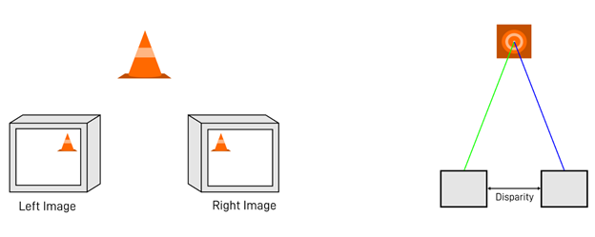
Stereo-vision
Why stereo vision over monocular vision?
Depth Perception
Improved Accuracy and performances
3D Reconstruction
At a higher computational Cost and setup can be tricky

Slide 4
Implementations and Project Setups
02
An overview on my project implementations, including calibration, rectification, and depth estimation using OpenCV

Slide 5
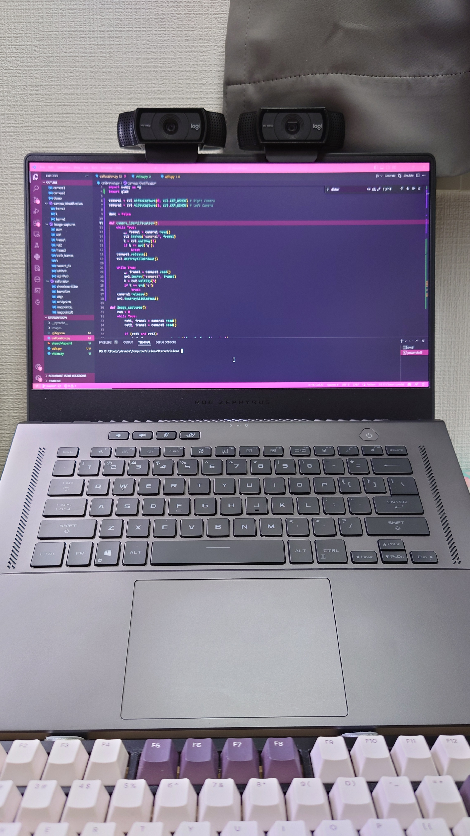
Camera Setup
Dual Logitech HD Pro C920 webcam
Easy to find, many used options
Good performance (1080p 30FPS)
Well Documented
Baseline: 9cm
Leveled to my best ability
Placed in a well-lit room during Calibration

Slide 6
Sotware Setup
The software implementation is rather simple and straight forward with the help of OpenCV
Calibration
Rectification
Disparity calculation & Depth estimation

Slide 7
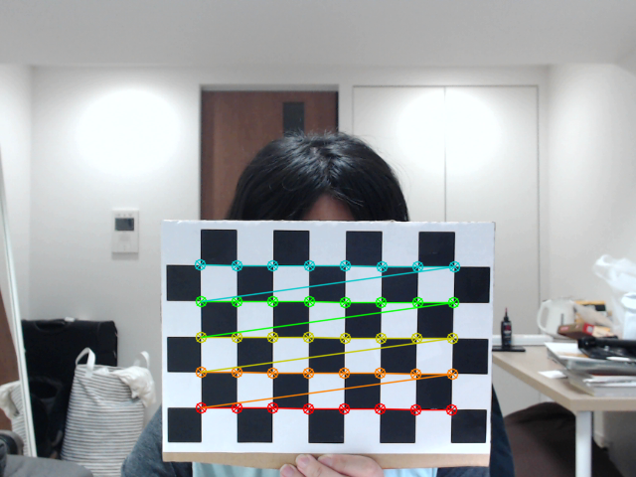
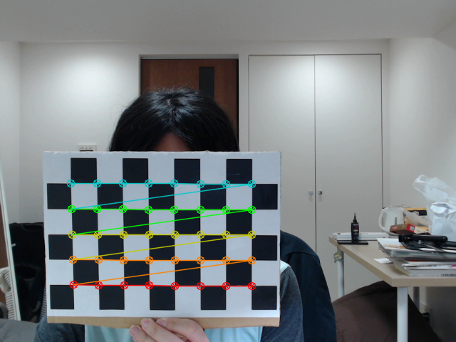
Calibration
The calibration is performed using a 9x6 chessboard pattern with an inner-dimension of 8x5:
Reference Pictures taken and separated into left and right
Converted to grey scale
Optimal Camera matrices calculated individually
Stereo Calibration then performed to obtain translation and rotation matrices

Slide 8
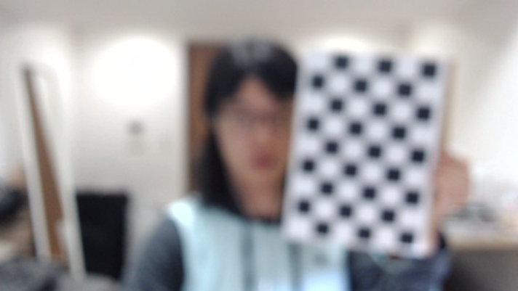
Difficulties
Despite the built-in chessboard detector’s conveniences, there are potential mistakes that can greatly affect the results
Blurry Images
Outliers
Exposure differences

Slide 9
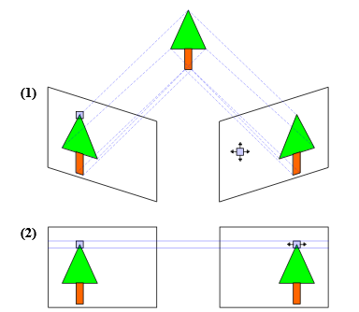
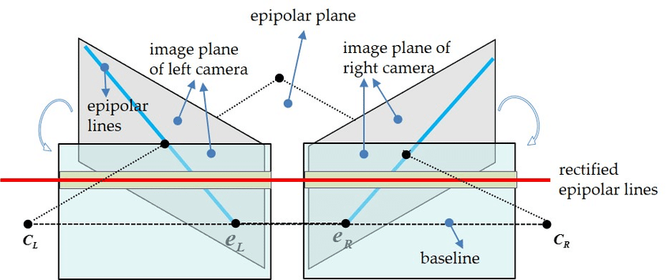
Rectification
Pairs the horizontal scan/epipolar lines
Matches the corresponding points
Calculate the lens distortion
Returns the corrected image

Slide 10
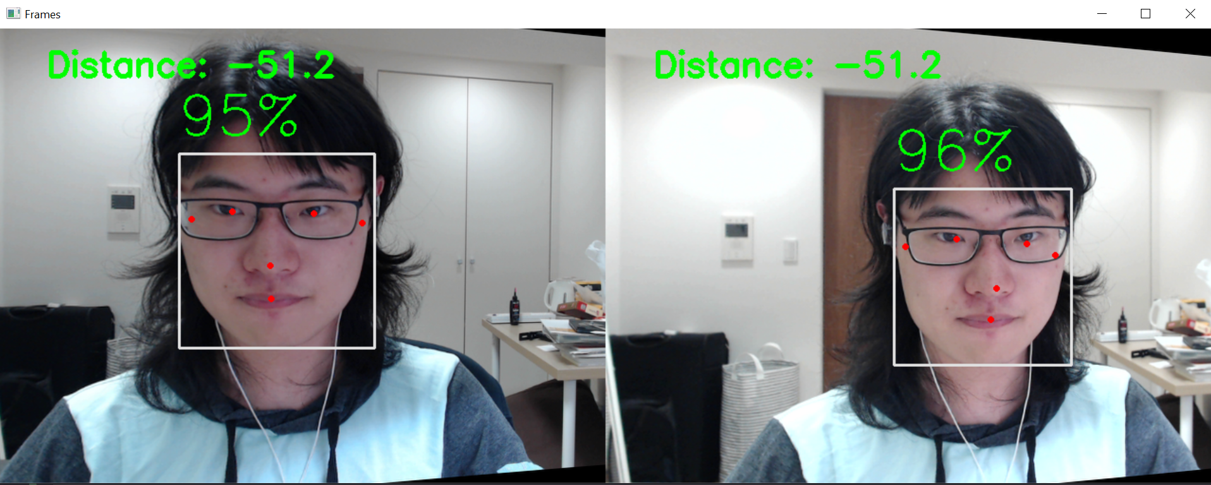

Depth Estimation
Applies distortion calibration and new Camera matrices
Demo uses an existing face tracker
Calculates the estimated distance from the middle point of the bounding box using disparity
Supports multiple targets

Slide 11
Quick Demonstration
03
A quick demo showing the project in action

Slide 12
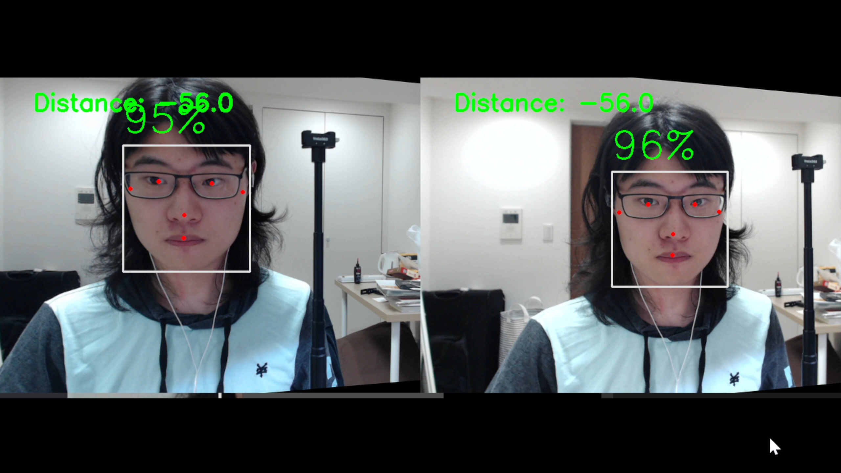
Quick Demo

Slide 13
The END
Thank you for listening!
Do you have any questions?
Please keep this slide for attribution

Slide 14
References
https://www.clearview-imaging.com/en/blog/stereo-vision-for-3d-machine-vision-applications
https://www.researchgate.net/figure/Stereo-vision-disparity_fig1_236455177
https://markhedleyjones.com/projects/calibration-checkerboard-collection
https://learnopencv.com/making-a-low-cost-stereo-camera-using-opencv/

